Slide 1

Mango IT Solutions
Placement Drive for Associate Software Engineer

Slide 2

Mango IT Solutions
ISO-certified best LAMP company of Central India.
15+ years of expertise in web and ecommerce development.
100% exports company with client base in USA, UK, Europe & Australia.
Web and mobile development company, working extensively on LAMP and Full Stack Development .
Specialize in web applications Ecommerce, mcommerce, CMS, custom and SAAS application.
Agile working company with 100% senior staff with Agile Scrum Master Certification.

Slide 3
About Us
10+ years of experienced working professionals.
Modern and environmental friendly infrastructure.
75+ team strength & growing.
“People Centric Company” focusing on overall growth & development of the employees.
Prioritize balanced professional life.
Promote process oriented & smart working.
We ensure complete transparency with clients by practicing effective communication & providing constant updates.

Slide 4
Life @ MIT
Work
Proper organization structure including work hierarchy.
Attention to detail and perfection.
Framework based coding with latest technologies.
Regularity in work.
5 Days a week working.

Slide 5
Life @ MIT
Fitness Lifestyle in Work:
Ergonomically sitting and standing furniture.
Open work Infrastructure with proper lighting and ventilation.
Morning and evening snacks.
Regular fitness and outdoor excursions.
Celebration
In house sports competition.
Festival and individual celebrations with team.
Happy and respectful atmosphere with smiles.

Slide 6
Work Culture
9:30 AM to 7:15 PM with flexible 45 minutes lunch & refreshments break timing.
5 days a week working.
18 annual leaves.
Clear and documented HR policies.
Open and transparent work culture.
Events, celebrations and engagement programs.
Tech-Talk every month.
Practice “Three C’s of culture -Communication, Core values & Commitment to Excellence.

Slide 7
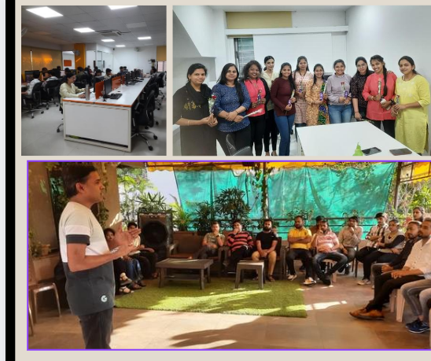
Glimpses of Events

Slide 8
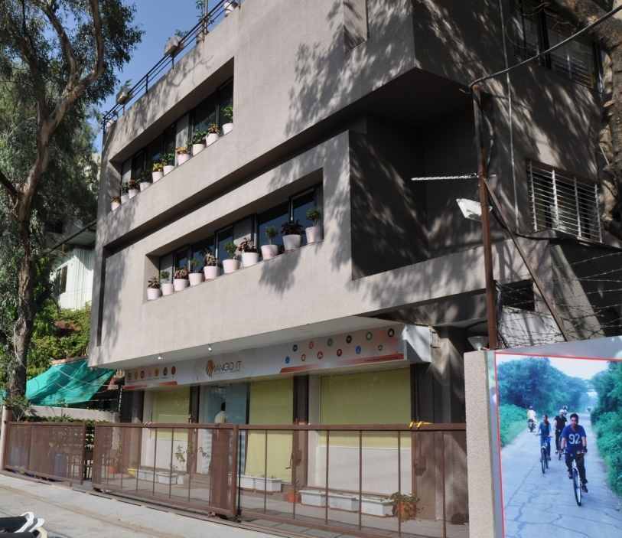
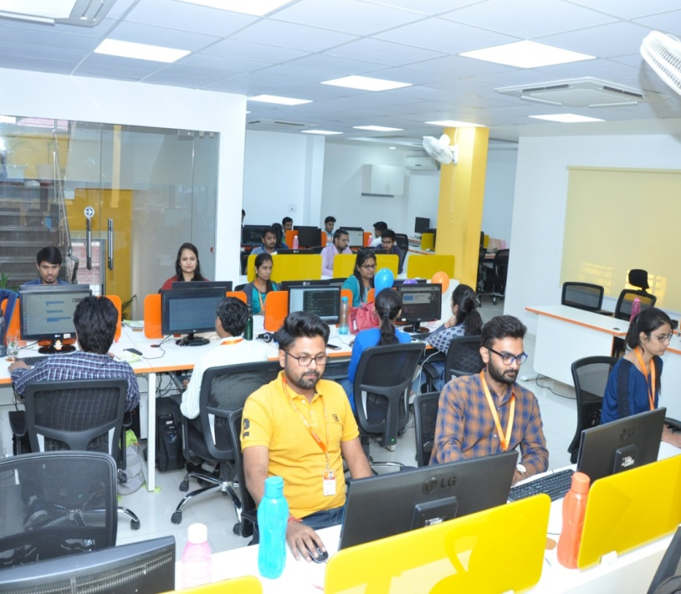
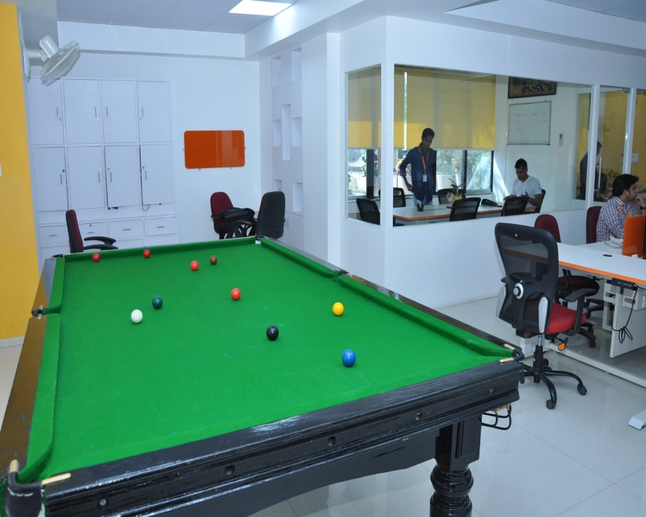
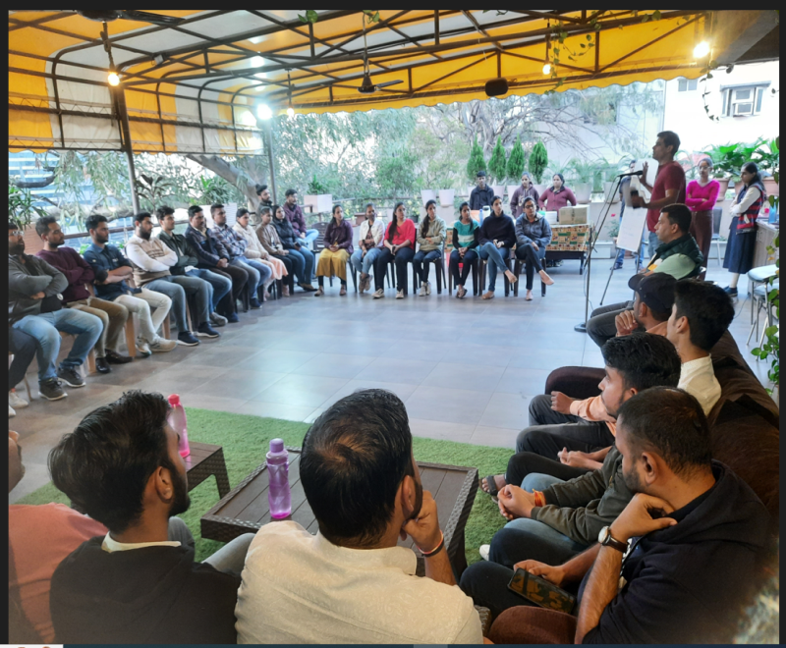

Slide 9
Hiring process
Direct Hiring – If you know full stack technologies and have working experience either on live environment or relevant projects in college.
On the Job training– Based on your skill – gap requirements we will train you full time with live projects on the job itself.

Slide 10
Training Program at MIS; What makes us different
6 months extensive training program.
On the job training with projects and practical assignments.
Stipend during training period.
Master OOPS concepts and MVC architecture .
Work under the direct supervision and guidance of project managers.

Slide 11
Compensation and Terms
Stipend Rs.10,000 per month for six months
Attractive salary
Retention bonus benefits.
2.5 yrs. of “Contract for Training”.
CTC | Work Tenure
3.85 LPA | 1-18 Months
5.05 LPA | 19-30 Months
5.65 LPA | 31-42 Months

Slide 12
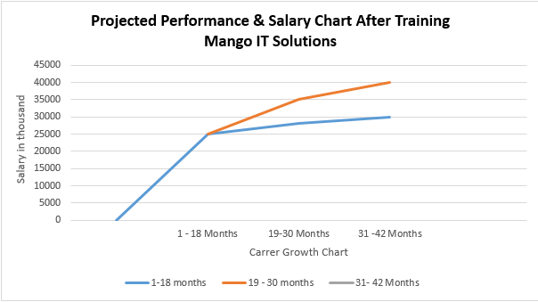
Projected Performance & Salary Chart

Slide 13
Projected Career Growth Plan

Slide 14
Training Module
Theoretical Training
11) CodeIgniter
12) Laravel 13) Wordpress 14) Functional Training of ecommerce 15) Functional Training of CMS 16) Quality Analysis 17) PLC (Project Life Cycle) 18) PD Classes
1) HTML & HTML 5
2) Responsive Web Design
3) Introduction to PHP
4) OOPs in PHP
5) Javascript
6) Jquery Introduction
7) Database
8) React
9) Angular
10) Node

Slide 15
Training Module
Live Project Training
Learn best practices with experienced senior software professionals.
Work with UI Designers & Quality Analysts for module Development.
Pre and post coding documentation.
Opportunity to work on live modules and client interaction.

Slide 16
Training Benefits
Advance level training for 3-6 months.
Training consists of basic to advance module.
In-house experienced trainers.
Training on latest tools and technologies.
On job training with Projects and practical assignments.
Exposure to work on live-project.
Mentor-Mentee system.
Daily/weekly assignment system.
Assignment on every task.
Scrum Master Certified Seniors.
More than 10+ years experienced trainers.
Training on entire project development life cycle.

Slide 17
Eligibility Criteria
Graduates with BE/PG degree in CS/ IT and 6+/10 grade .
Coding experience in any technology with clear oops concepts.
Dedicated personality with a zeal to learn & good command on English.
Should be able to clear the technical interview and on-line test based on OOPS, English, MySQL, Data structure and Programming concepts.

Slide 18
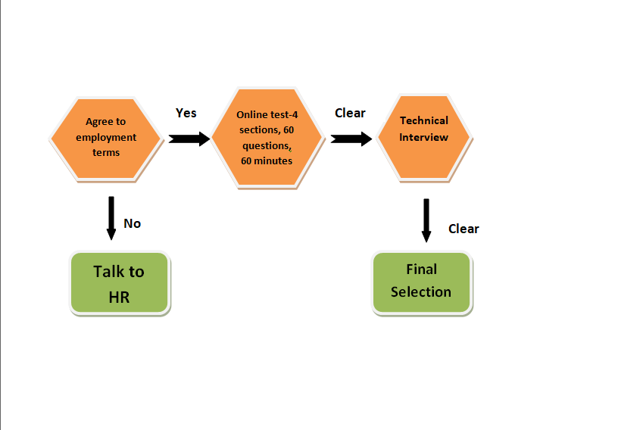
Selection Process

Slide 19

Any Questions ???
Vaishnavi Panchbhai – HR Executive
Mango IT Solutions 15/3 Old Palasia, Behind Sarda House, Indore Phone No. : 4046693 Ext. 21/22
career@mangoitsolutions.com
hr@mangoitsolutions.com

